Slide 1


Slide 2
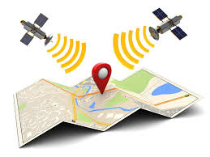

Slide 3
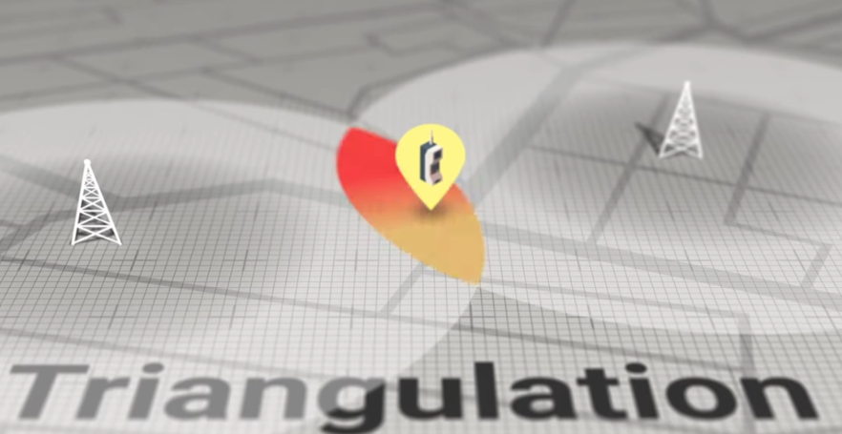

Slide 4


Slide 5
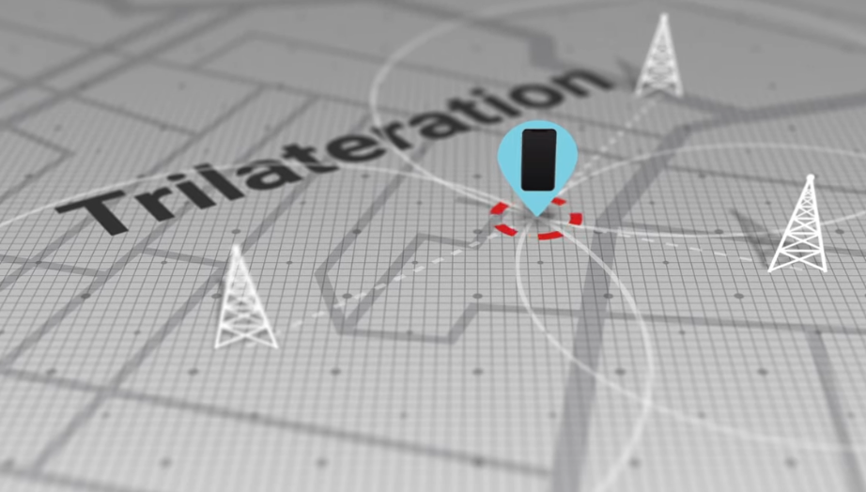
Based on the time of arrival of a message to every cell towers

Slide 6
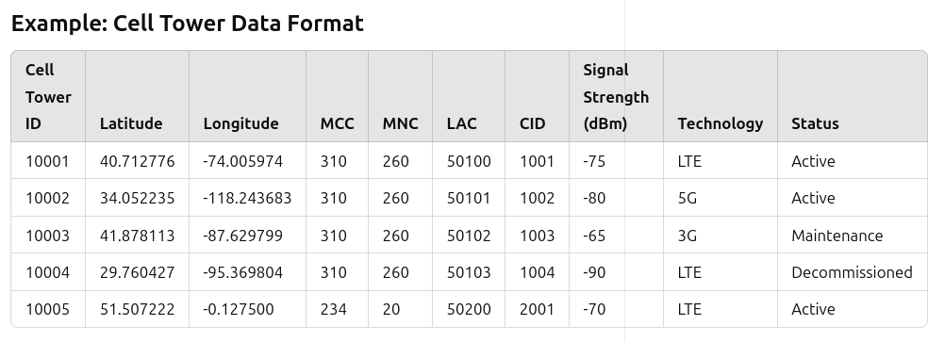

Slide 7
Cell Tower ID: Unique identifier for the cell tower.
Latitude/Longitude: Geographical location of the tower.
MCC (Mobile Coauntry Code): Identifies the country (e.g., 310 = USA, 234 = UK).
MNC (Mobile Network Code): Identifies the operator (e.g., 260 = T-Mobile).
LAC (Location Area Code): Identifies a group of towers in the network.
CID (Cell ID): Unique ID of the cell within the LAC.
Signal Strength (dBm): Indicates signal quality, where values closer to 0 are stronger.
Technology: The technology used (e.g., LTE, 5G, 3G, etc.).
Status: Operational status of the tower (e.g., Active, Maintenance, Decommissioned).

Slide 8


Slide 9
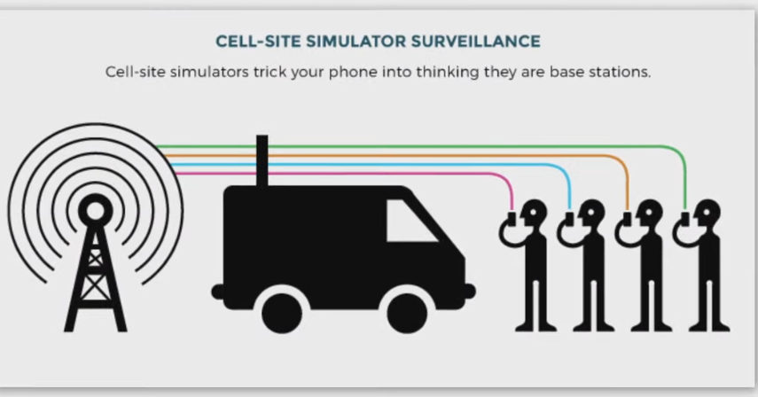

Slide 10
